Slide 1
实时可交互流体模拟Interactive Fluid Simulation in Real Time
Lecturer：Yu Zhang
Instructor：Xiaosheng Li

Slide 2
Contents
Motivation
Background
SPH
PBF
Rendering
Mobile
Conclusion

Slide 3
Motivation

Slide 4

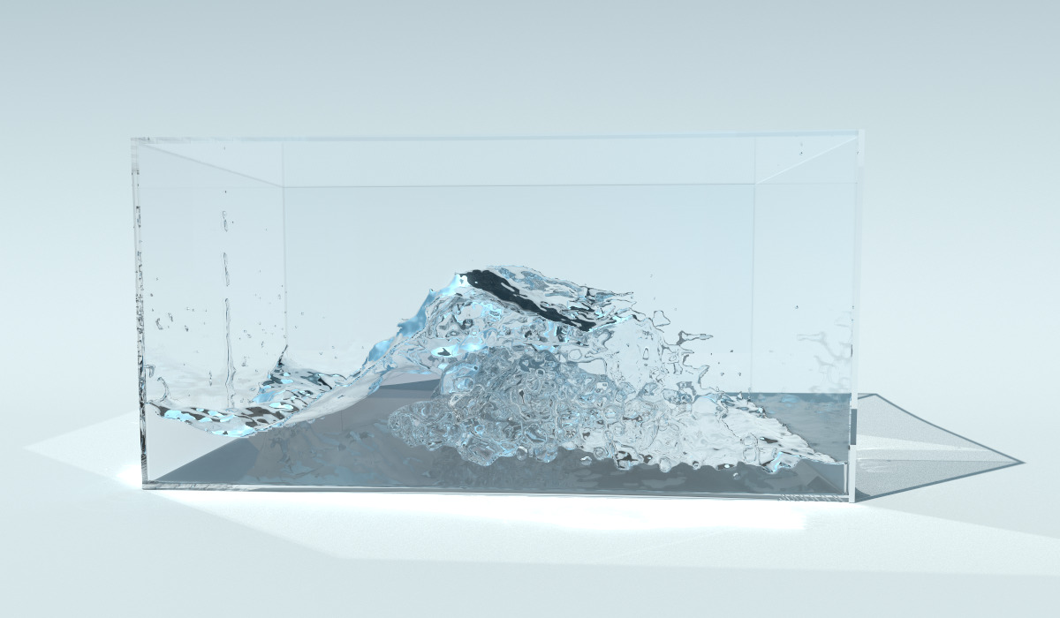
Motivation

Slide 5
Motivation
Aim
Interactive fluid simulation on mobile in real time
Method
Solving N-S Equation: SPH & PBF
Rendering: Marching Cubes & SSFR
Fully on GPU

Slide 6
Background

Slide 7
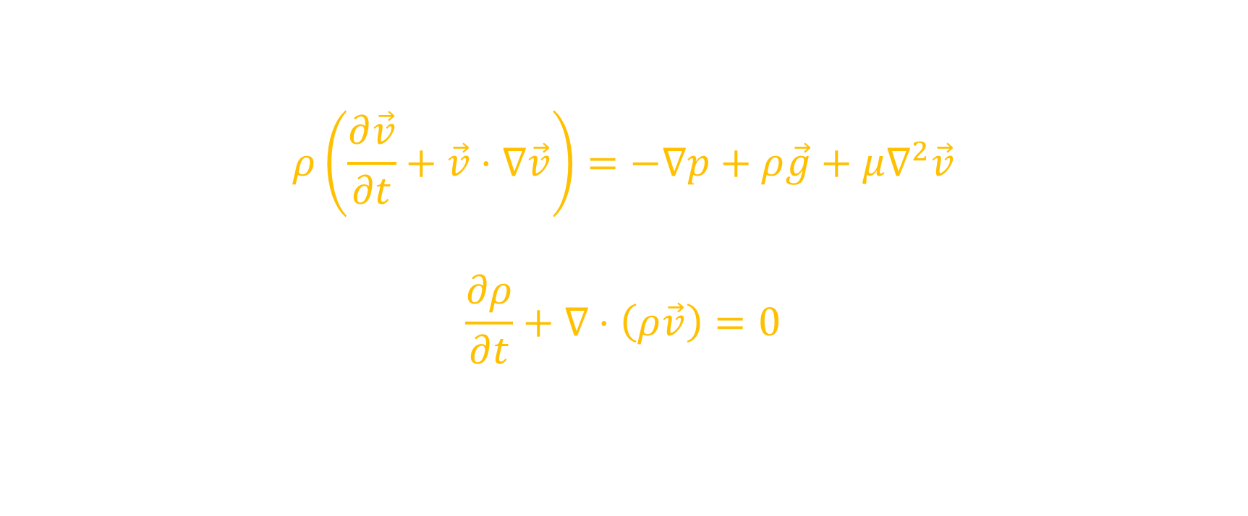
Navier-Stokes Equation
$$ρ\left(\frac{∂\vec{v}}{∂t}+\vec{v}⋅∇\vec{v}\right)=−∇p+ρ\vec{g}+μ∇^{2}\vec{v}$$
$$\frac{∂ρ}{∂t}+∇⋅\left(ρ\vec{v}\right)=0$$

Slide 8
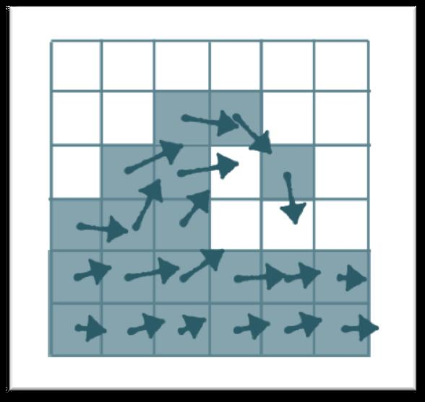
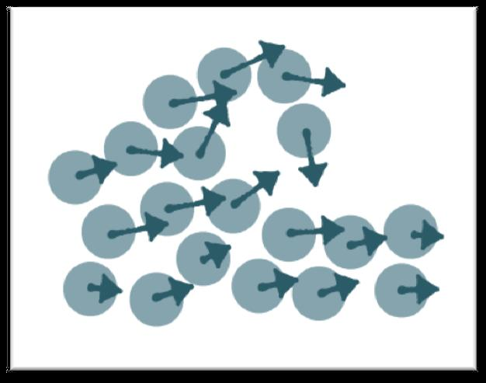
Solving N-S Equation
Eulerian (grids)
Lagrangian (particles)

Slide 9
Fluid Simulation
Scale
Small: Particle
Medium: Particle/Grid
Large: Wave simulation

Slide 10
Solving N-S Equation
Grid
Advantages
Easy to approximate: finite difference
Disadvantages
Mass non-conservation leads to dissipation: sticky & mass losing
Massive grids when need details
Particle
Advantages
Mass conservation
Better to simulate details
Convenient to couple with other physical simulations
Disadvantages
Neighbor searching

Slide 11
SPH
Smooth Particle Hydrodynamics

Slide 12
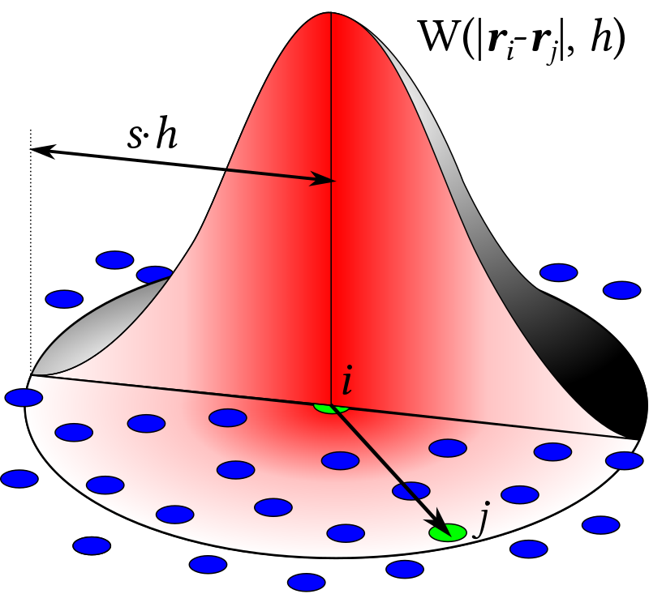
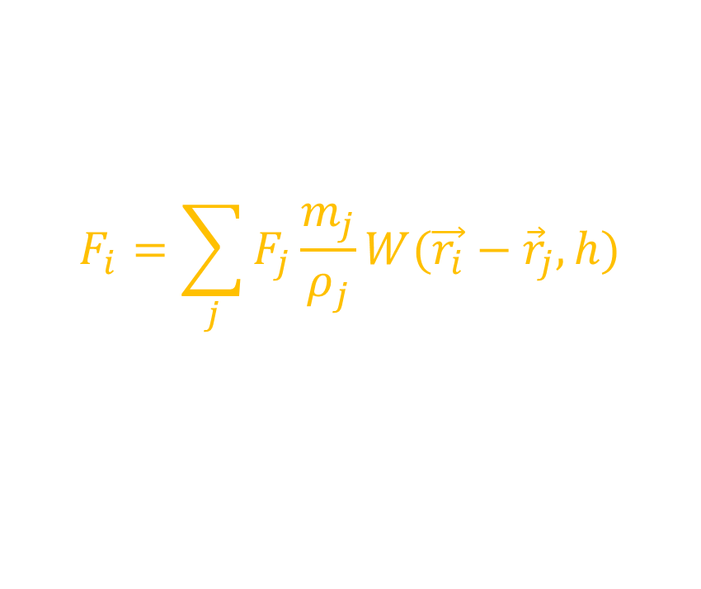
SPH Approximation
$$F_{i}=\sum_{j}{F_{j}\frac{m_{j}}{ρ_{j}}W(\vec{r_{i}}−{\vec{r}}_{j}, h)}$$

Slide 13

SPH Approximation
Example
$$ρ_{i}=\sum_{j}{m_{j}W({\vec{r}}_{i}−{\vec{r}}_{j}, h)}$$
$${\vec{f}}_{i}^{pressure}=−\sum_{j}{m_{j}\frac{p_{i}+p_{j}}{2ρ_{j}}∇W({\vec{r}}_{i}−{\vec{r}}_{j},h)}$$
$${\vec{f}}_{i}^{viscosity}=μ\sum_{j}{m_{j}\frac{{\vec{v}}_{j}−{\vec{v}}_{i}}{ρ_{j}}∇^{2}W({\vec{r}}_{i}−{\vec{r}}_{j},h)}$$

Slide 14
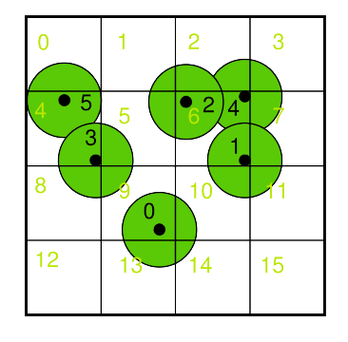
Neighbor Searching
Space partition

Slide 15
Neighbor Searching
Space partition
List

Slide 16
Neighbor Searching
Space partition
Sorting

Slide 17
Neighbor Searching
Space partition
List ◊
Sorting √
 | Locality | Performance (125k particles)
 |  | Pre-Processing | Neighbor Accessing
List | Very bad! | 0.6ms | 88ms
Sorting | Good | 1.4ms | 10ms

Slide 18
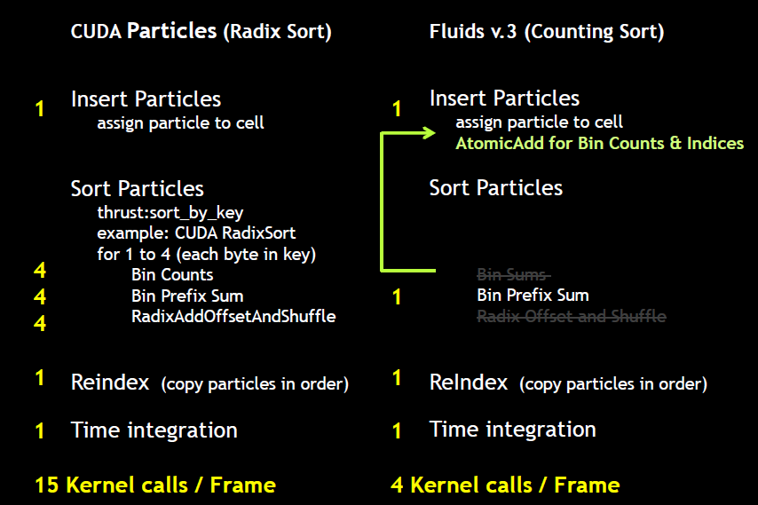
Neighbor Searching
Space partition
Sorting
Radix sorting
Counting sorting √

Slide 19
Neighbor Searching
Prefix Sum

Slide 20
Neighbor Searching
Prefix Sum

Slide 21
Neighbor Searching
Prefix Sum

Slide 22
Neighbor Searching
Optimization in GPU Sorting
Locality
Atomic operations
Global/Shared memory
Bank conflicts

Slide 23
SPH Algorithm
Neighbor searching
Update density and pressure
Update forces
Update velocity and position
Collision handling
Notes:
todo

Slide 24


Problems
$$ρ_{i}=\sum_{j}{m_{j}W({\vec{r}}_{i}−{\vec{r}}_{j}, h)}$$
Density problem
Single particle mass is set very large to get expected density
Adjust parameters to achieve expected simulation effect
Mass
Volume
Time Step
Smooth Radius ($h$)

Slide 25
PBF
Position Based Fluids

Slide 26

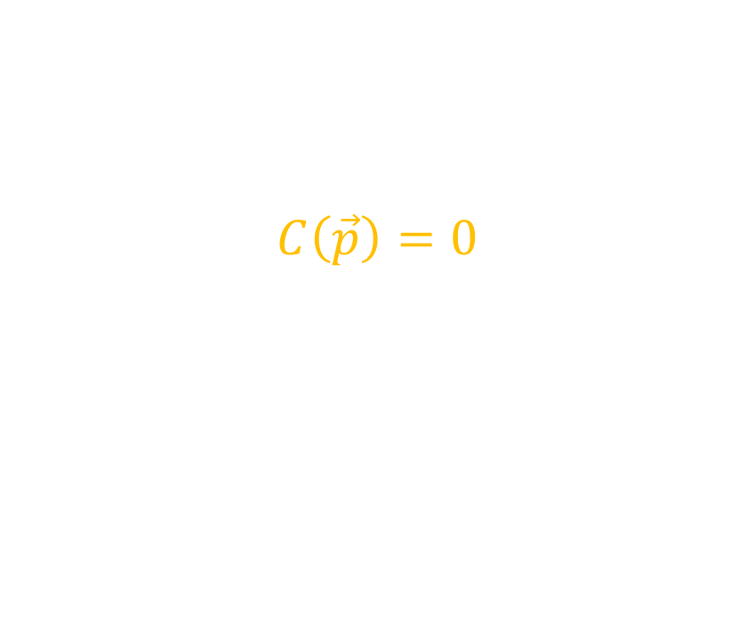
Position Based Dynamics (PBD)
$$C\left(\vec{p}\right)=0$$
Example
$$C_{circle}\left(\vec{p}\right)=\left|\vec{p}−\vec{c}\right|−r$$
$$C_{stretch}\left({\vec{p}}_{1},{\vec{p}}_{2}\right)=\left|{\vec{p}}_{1}−{\vec{p}}_{2}\right|−d$$

Slide 27
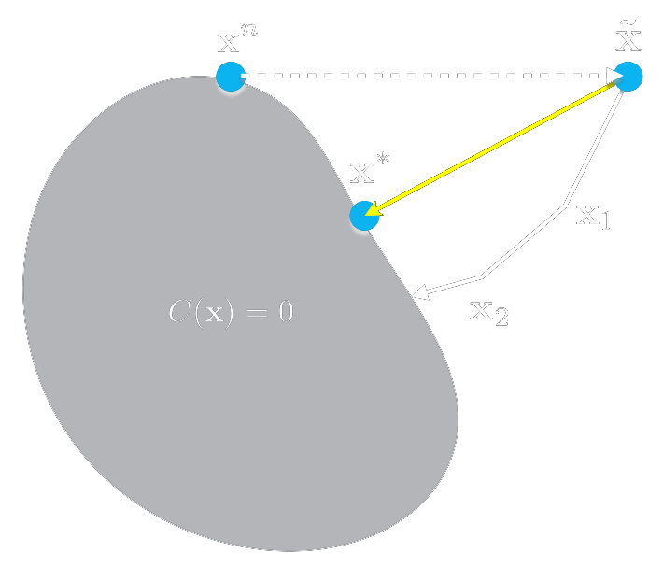

Position Based Dynamics (PBD)
$C\left(\vec{p}+Δ\vec{p}\right)≅$
$C\left(\vec{p}\right)+∇_{\vec{p}} C\left(\vec{p}\right)⋅Δ\vec{p}=0$
$Δ\vec{p}=λ∇_{\vec{p}}C(\vec{p})$

Slide 28
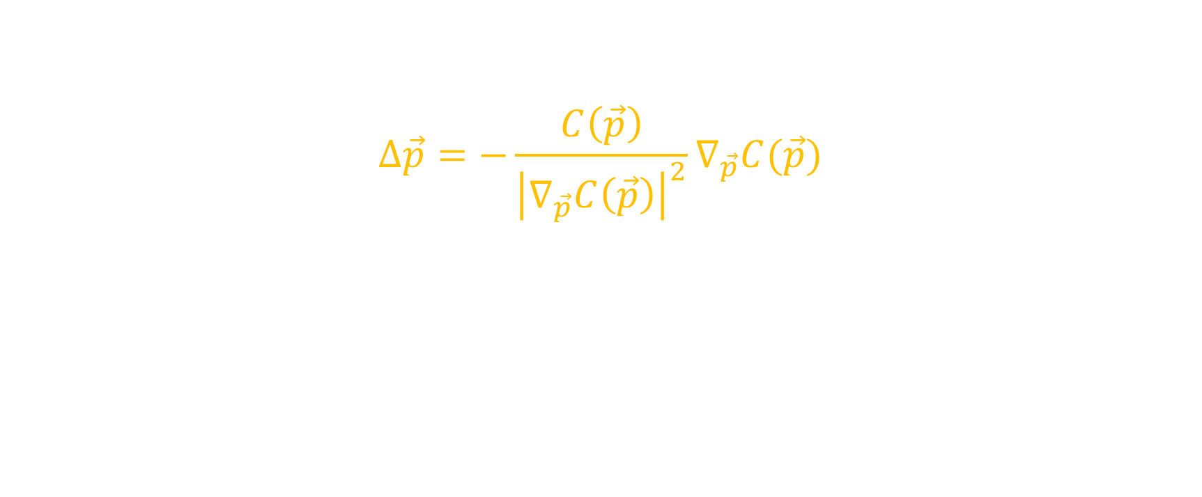
Position Based Dynamics (PBD)
$$Δ\vec{p}=−\frac{C\left(\vec{p}\right)}{{\left|∇_{\vec{p}}C\left(\vec{p}\right)\right|}^{2}}∇_{\vec{p}}C(\vec{p})$$

Slide 29
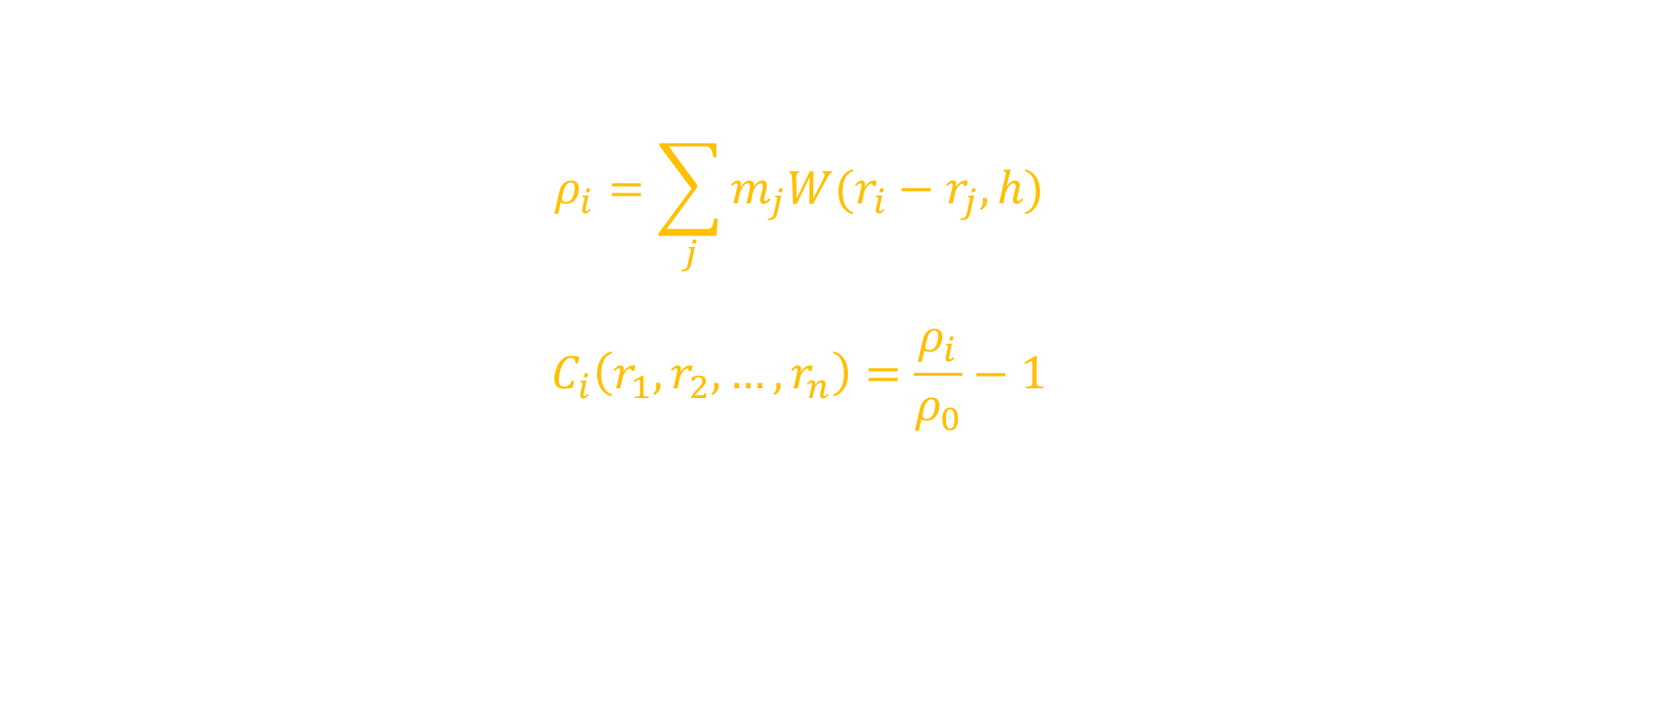
Position Based Fluids (PBF)
SPH + PBD
$$ρ_{i}=\sum_{j}{m_{j}W(r_{i}−r_{j}, h)}$$
$$C_{i}\left(r_{1},r_{2},…,r_{n}\right)=\frac{ρ_{i}}{ρ_{0}}−1$$

Slide 30
Solving Constraints
Direct Method ◊
Iterative Method √
Gauss-Seidel method
Jacobi method √
 | Single Thread | Multiple Threads
Gauss-Seidel | Converges fast | ◊
Jacobi | Converges slow | √
Notes:
Direct method can not solve nonlinear equations
Iterative method is more stable

Slide 31
PBF Algorithm
Neighbor searching
Predict position
Jacobi iteration
Neighbor searching
Calculate lambda
Correct Position
Update velocity
XSPH

Slide 32
Demo
Video
SPH vs. PBF (125k particles)

Slide 33
Comparison
 | Parameters | Stability | Performance | Scalability
SPH | Fake parameters, time consuming to adjust parameters | Not stable, sensitive to parameters | Adjust parameters to optimize performance | Not easy to couple with other physical simulation
PBF | Real physical parameters | Stable. Increase iterations | Reduce iterations | Convenient to couple with others physical simulation due to the feature of PBD (PhysX, Flex)

Slide 34
Demo
Video
Real Time Simulation (PBF, 6 iterations, 16k particles, 60fps)

Slide 35
Current Performance
PBF, 6 iterations, compute shader in Unity, GTX 750Ti
Particles | 27k | 64k | 125k | 216k
FPS (No Rendering) | 75 | 45 | 25 | 15

Slide 36
Future Optimization
Locality
Atomic operations
Global/Shared memory
Bank conflicts
Other GPU optimizations

Slide 37
Rendering

Slide 38
Rendering
Marching Cubes (1987)
Screen Space Fluid Rendering (SSFR, 2009)

Slide 39
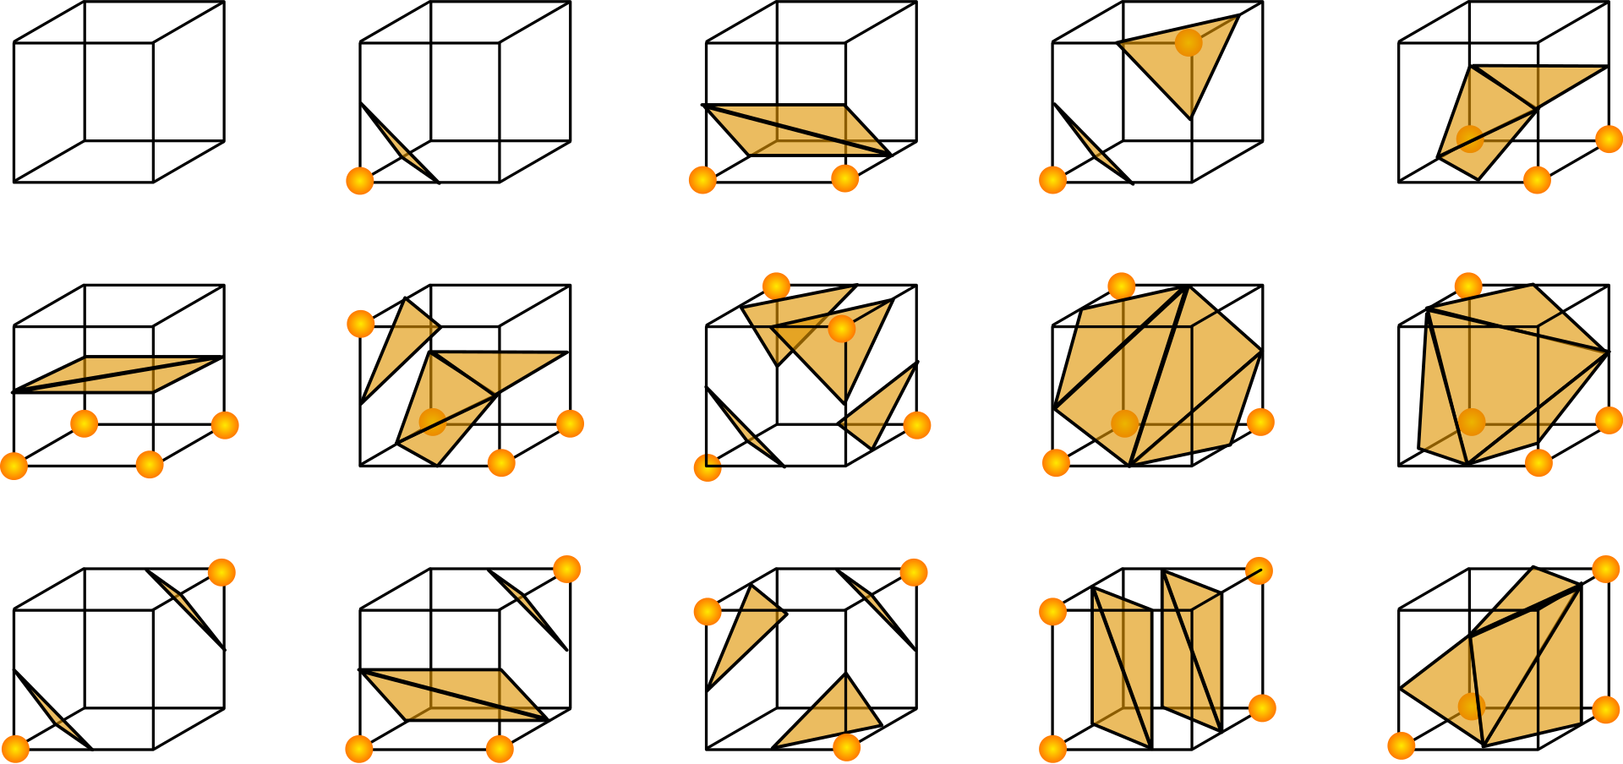
Marching Cubes

Slide 40
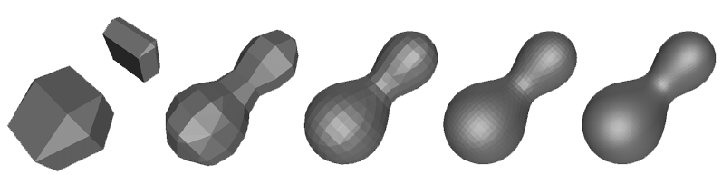
Problems

Slide 41
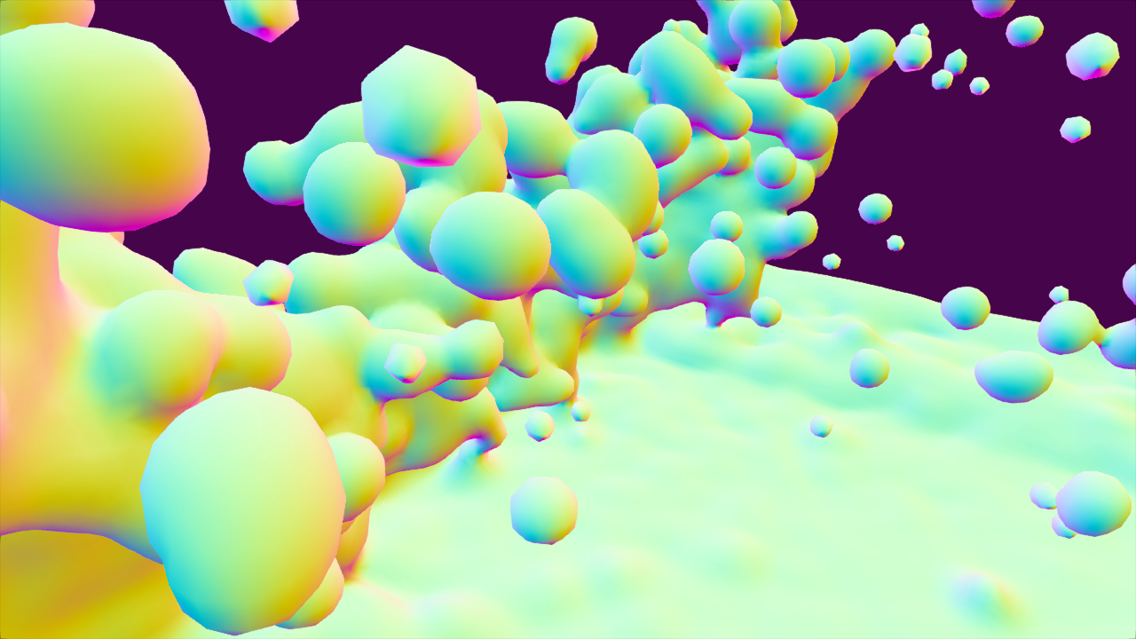
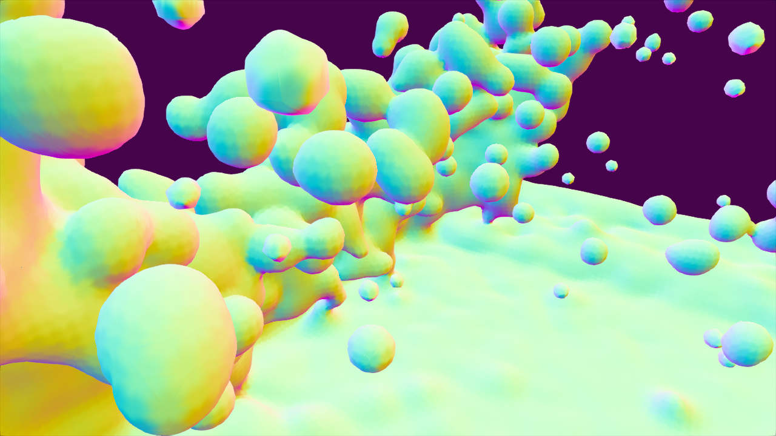
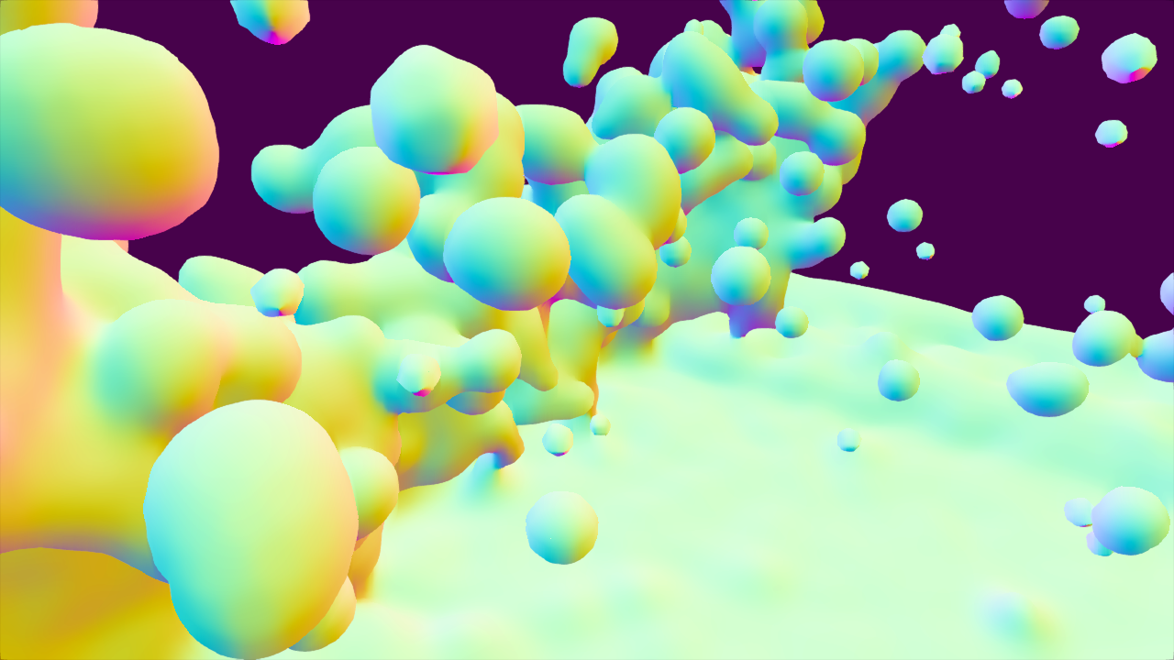
Optimization
Triangles subdivision: PN triangles
Normal smoothing: Bilateral filtering

Slide 42
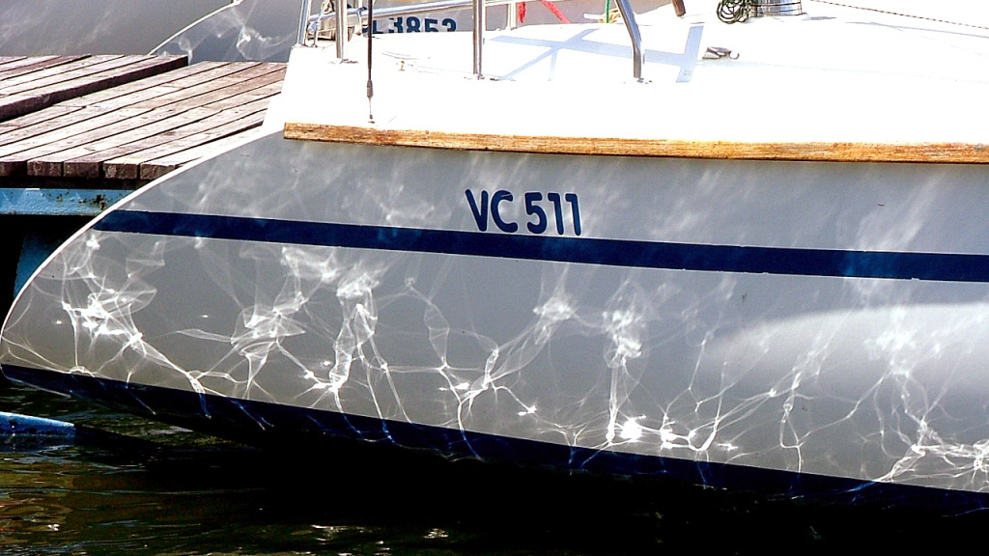
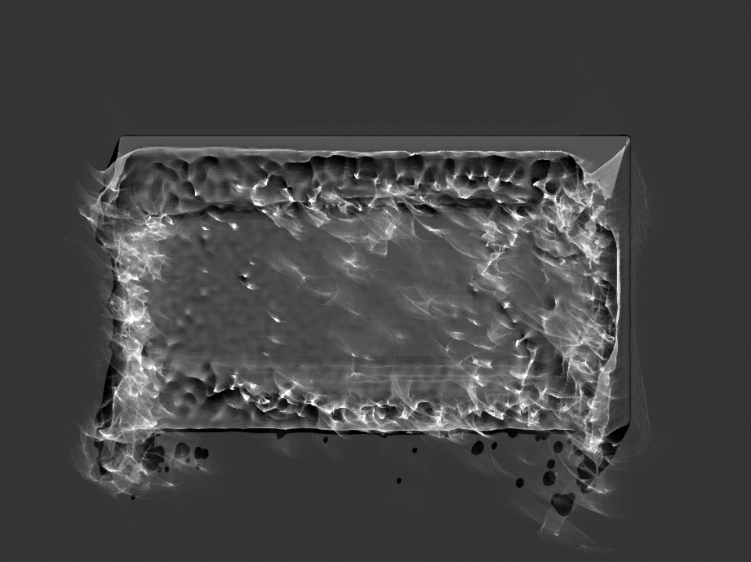
Caustics
Geometry method

Slide 43
Demo
Video
MC Final Rendering
MC Smoothing

Slide 44
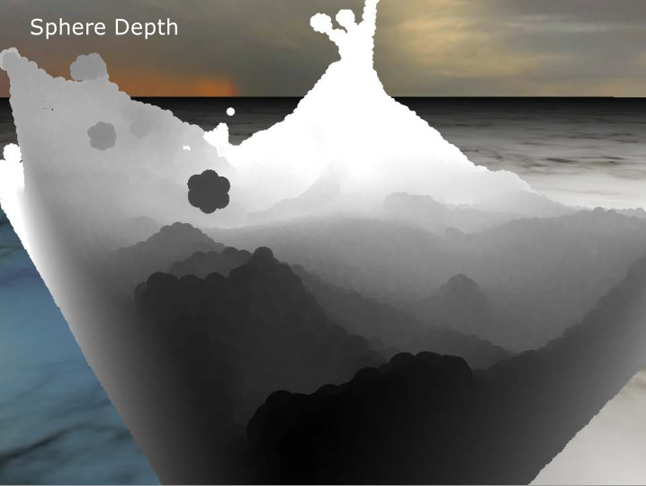
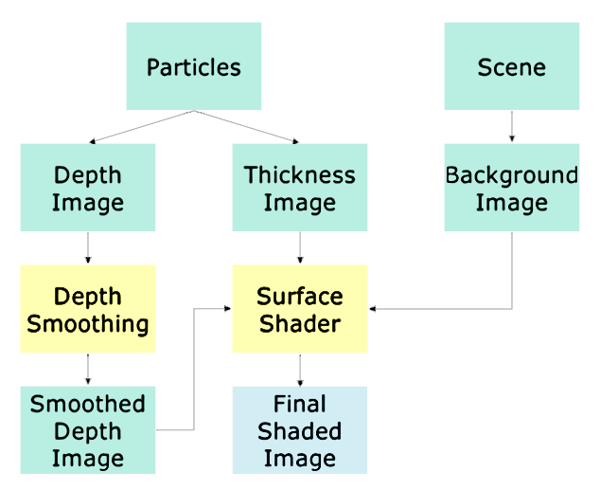
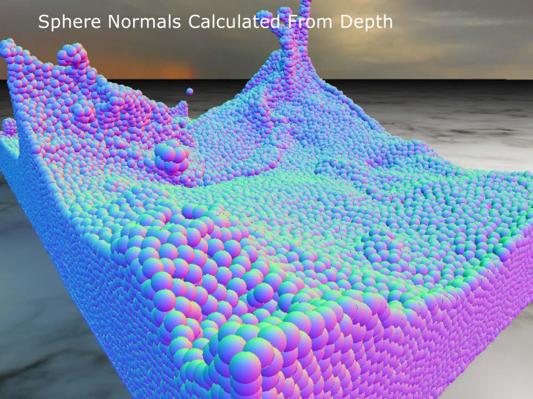
Screen Space Fluid Rendering (SSFR)

Slide 45
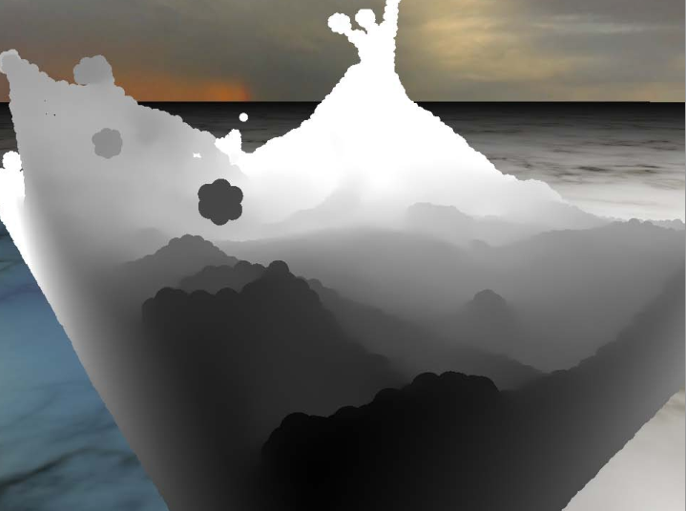
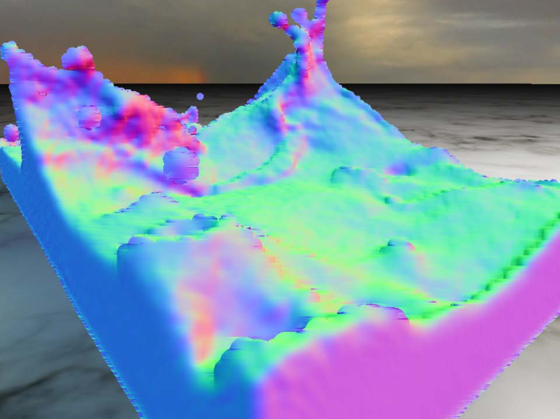
Normal Smoothing

Slide 46
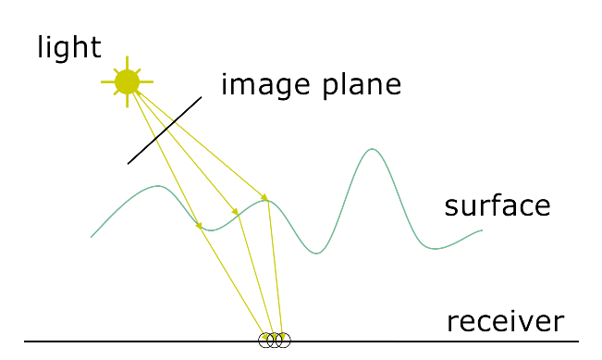
Caustics

Slide 47
Demo
Video
MC vs. SSFR

Slide 48
Comparison
Small scale (<5k / Near) : Marching Cubes
Large scale (>10k / Far) : SSFR
 | Performance | Visual Effect | Memory | Parameters
Marching Cubes | Decrease heavily with grid resolution | Depend on grid resolution | Increase with grid resolution | Easy
SSFR | Depend on the number of pixels | Good when viewpoint is far, obvious artifact when view is near | Several Textures | Need tricks

Slide 49
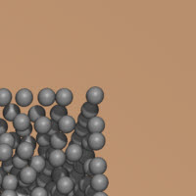
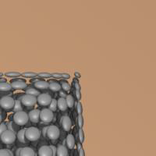
Optimization
Performance
Caustics must die
Bilateral filtering two directions separately (approximation)
Visual Effect
Blurring Radius view invariant
Anisotropic particles

Slide 50
Mobile
Android, Xiaomi6
Qualcomm Adreno 540, Vulkan 1.0.61

Slide 51
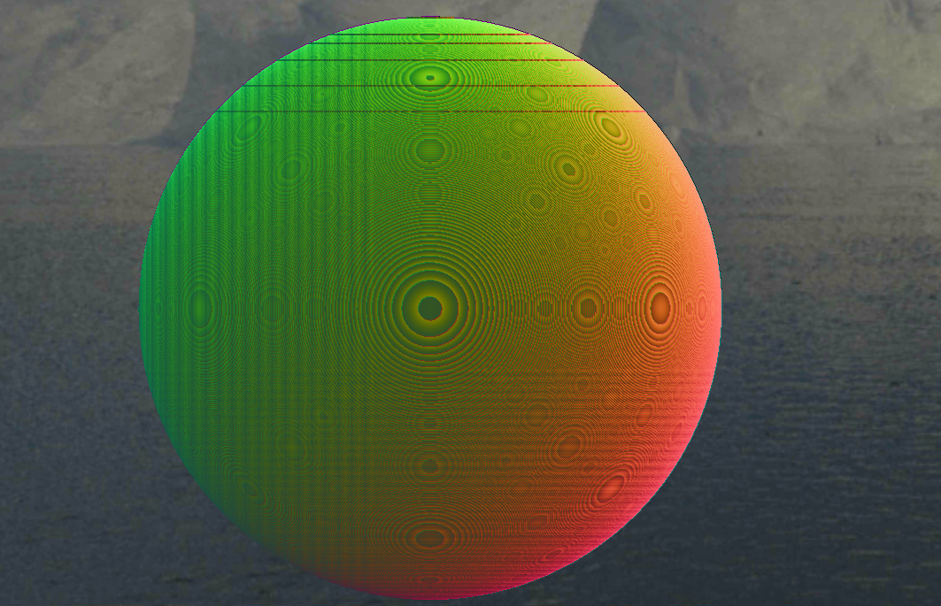
Problems
Geometry shader : Generate triangles in compute shader (Point Sprites)
Texture formats / MRT supported : Use alternative format
Precision (restore normal in SSFR) : highp

Slide 52

Current Performance
PBF, 2 iterations, Marching Cubes 80$×$40$×$40
Android, Xiaomi6
Qualcomm Adreno 540, Vulkan 1.0.61
 | 1k particles | 5k particles
With rendering | 30fps | 25fps
Without rendering | 60fps | 40fps

Slide 53
Future Optimization
Sorting
Optimization methods on mobile

Slide 54
References
Stam, Jos. "Stable fluids." Acm Transactions on Graphics1999(1999):121--128.
Liu G R , Liu M B . Smoothed Particle Hydrodynamics (SPH): an Overview and Recent Developments[J]. Archives of Computational Methods in Engineering, 2010, 17(1):25-76.
Müller, Matthias, David Charypar, and Markus Gross. "Particle-based fluid simulation for interactive applications." Proceedings of the 2003 ACM SIGGRAPH/Eurographics symposium on Computer animation. Eurographics Association, 2003.
Solenthaler, Barbara, and Renato Pajarola. "Predictive-corrective incompressible SPH." ACM transactions on graphics (TOG). Vol. 28. No. 3. ACM, 2009.
Müller, Matthias, et al. "Position based dynamics." Journal of Visual Communication and Image Representation 18.2 (2007): 109-118. Macklin, Miles, and Matthias Müller. "Position based fluids." ACM Transactions on Graphics (TOG) 32.4 (2013): 104.
Harris, Mark, Shubhabrata Sengupta, and John D. Owens. "Parallel prefix sum (scan) with CUDA." GPU gems 3.39 (2007): 851-876. van der Laan, Wladimir J., Simon Green, and Miguel Sainz. "Screen space fluid rendering with curvature flow." Proceedings of the 2009 symposium on Interactive 3D graphics and games. ACM, 2009.
Yu, Jihun, and Greg Turk. "Reconstructing surfaces of particle-based fluids using anisotropic kernels." ACM Transactions on Graphics (TOG) 32.1 (2013): 5.
Green, Simon. "Cuda particles." NVIDIA whitepaper 2.3.2 (2008): 1.
Hoetzlein, R. C. "Fast fixed-radius nearest neighbors: interactive million-particle fluids." GPU Technology Conference. Vol. 18. 2014.
软件学院. 不可压平滑粒子流体动力学算法GPU并行加速及其应用研究[J]. 清华大学, 2013.

